Slide 1
Final Class Review
K.G. Field^{1,a},
ª kgfield@umich.edu
¹University of Michigan

Slide 2


Final Exam Structure
Same general format at Mid-Term
Non-cumulative, use slides as guide for topics to be covered

Slide 3
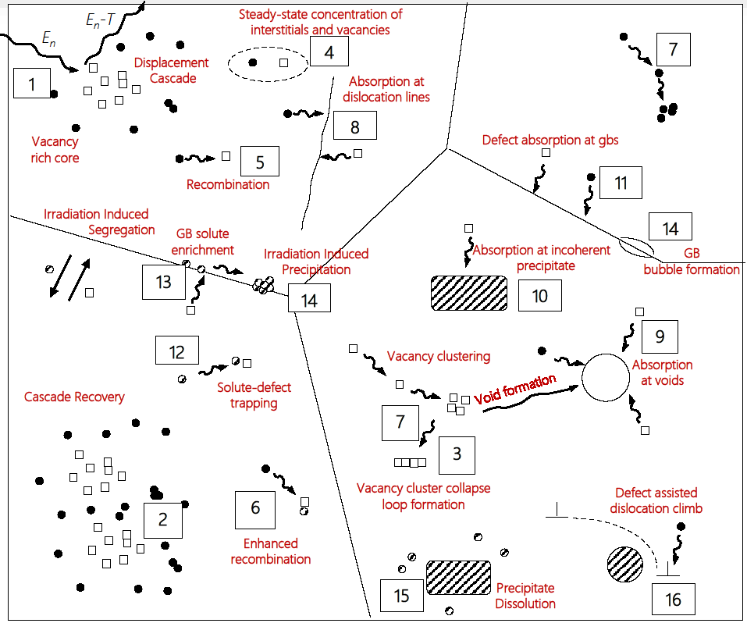
Putting it into a visual

Slide 4

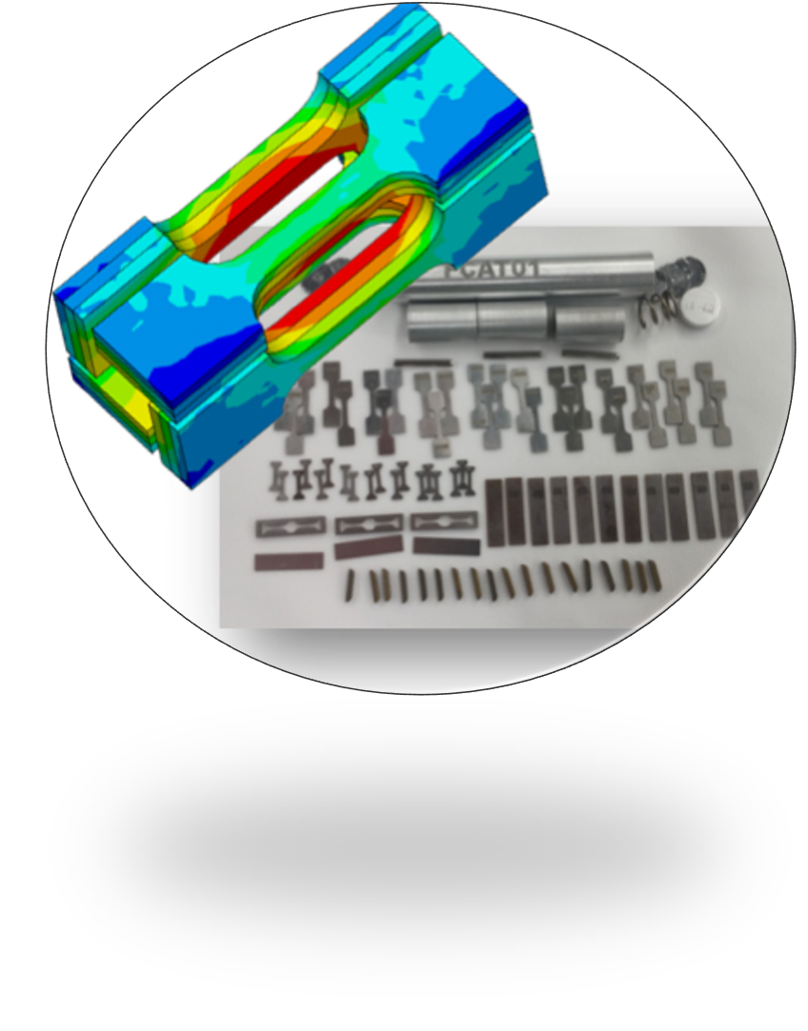


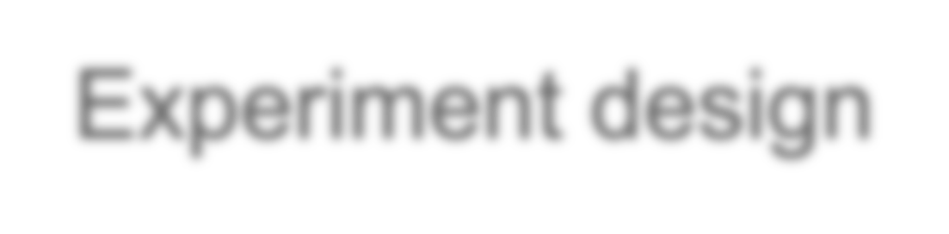
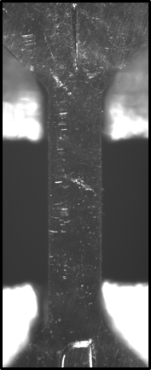
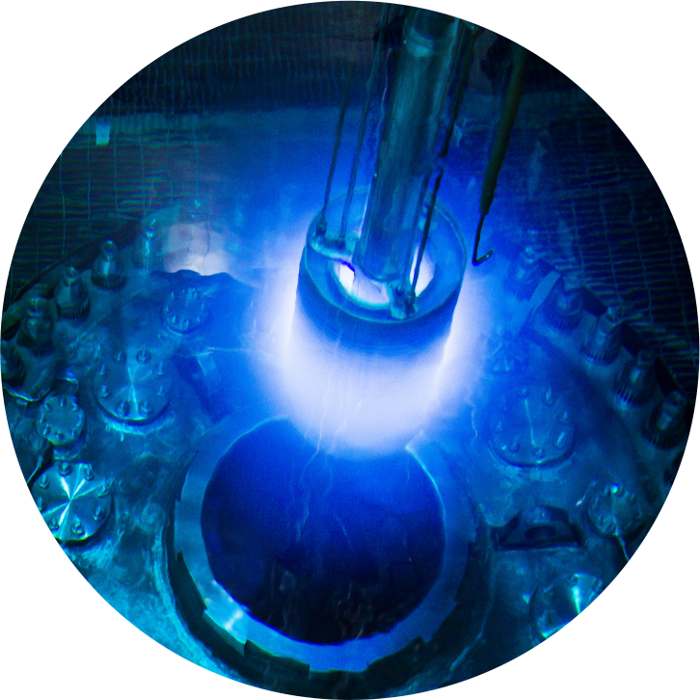

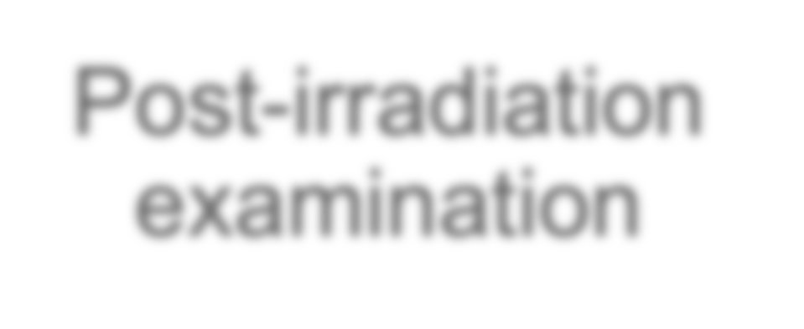



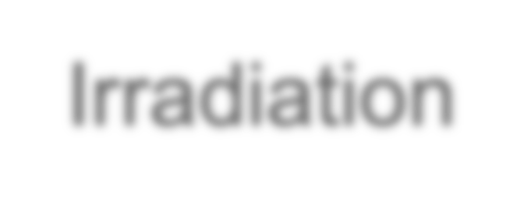
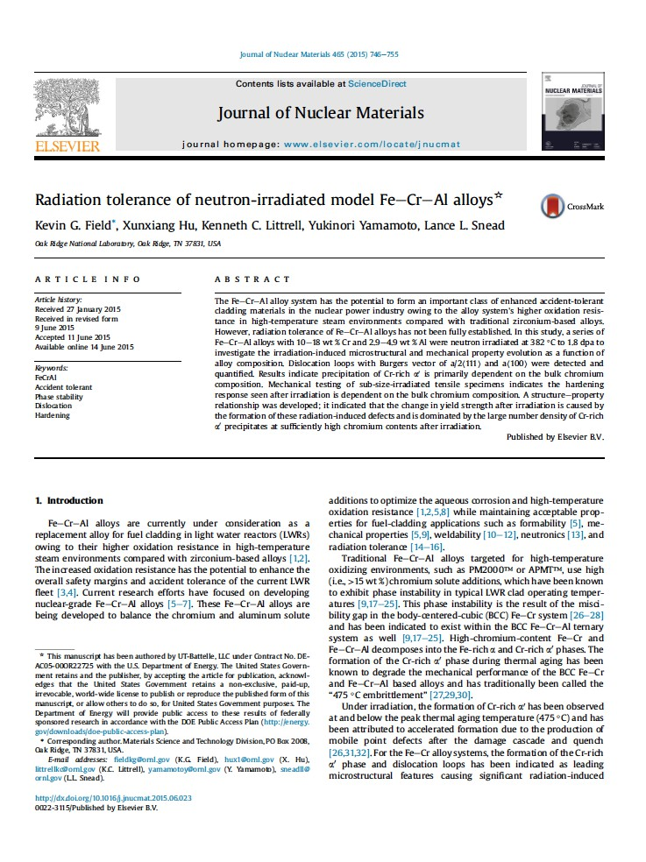

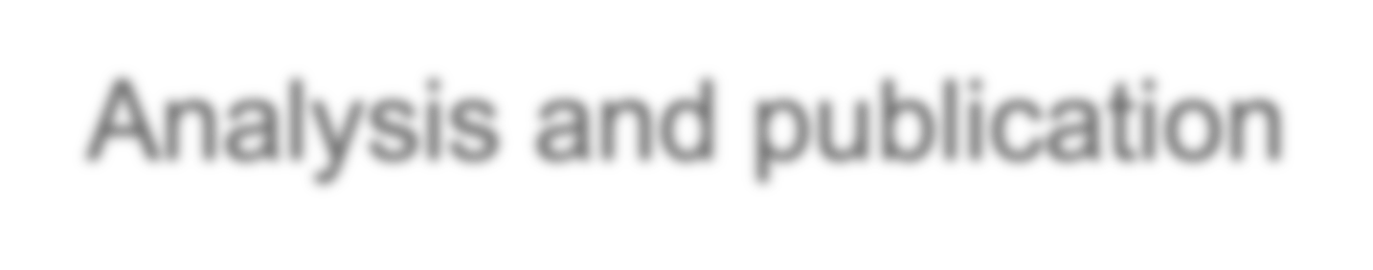

Irradiation experiment workflow overview
Preparation of experiment campaign
Experiment design
Post-irradiation examination
Irradiation
Analysis and publication

Slide 5
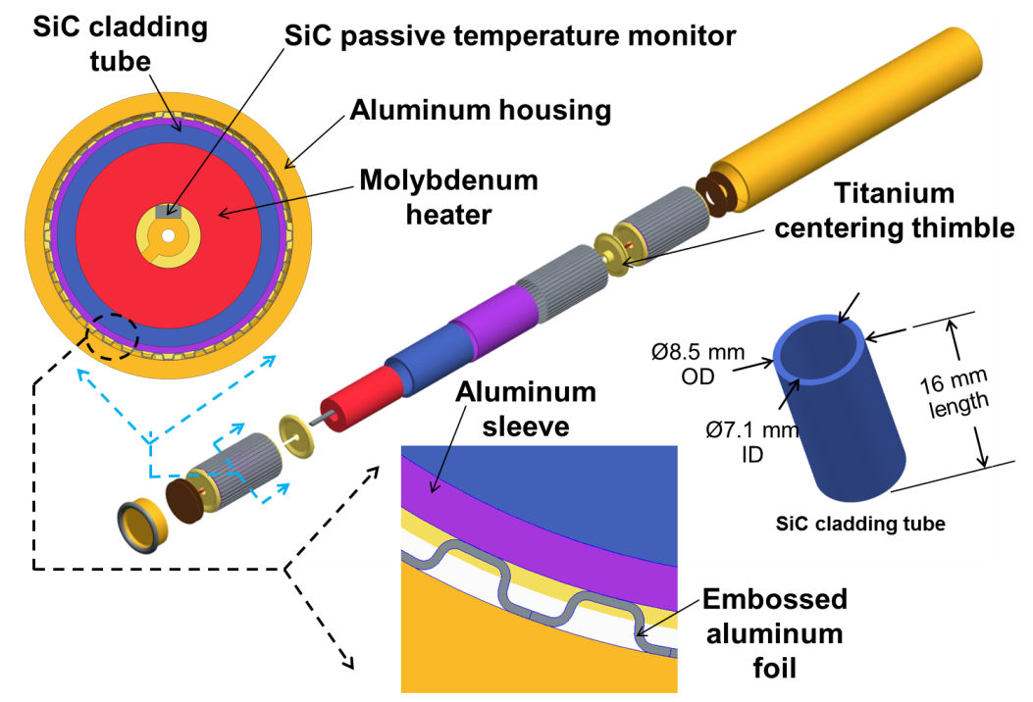
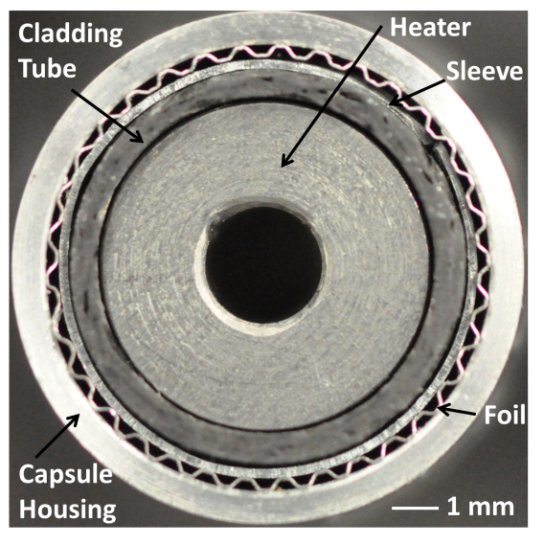
In-reactor Design
Cycle length/duty cycle (e.g. what’s my dose/year)
Power/flux stability per cycle (e.g. how stable?)
Experimental space (e.g. what’s the biggest thing I can put in it?)
In-situ monitoring/test capabilities
Spectrum, He/dpa, and/or transmutation effects
Uniformity of irradiation (e.g. axial peaking)
Acceptability of data to regulator (e.g. can ion beam data be used to build a neutron source?)
Accessibility (will changing political/economic environments impact my science?)
Operating temperature capabilities
Cost

Slide 6
Sinks and defect reactions
Grain boundaries and voids classicly act as ___________?
Neutral sinks
Biased sinks
Variable sinks
You are asked to derive the reaction rate for a platelet precipitate and get a prefactor of 4𝝅 to account for the geometry. How much confidence do you have in your answer?
Low
Moderate
High

Slide 7
Sinks and defect reactions
Which of the following defects/sinks are NOT unique to irradiated materials microstructures?
Line dislocations
Helium bubbles
Radiation-induced segregation
Dislocation loops

Slide 8
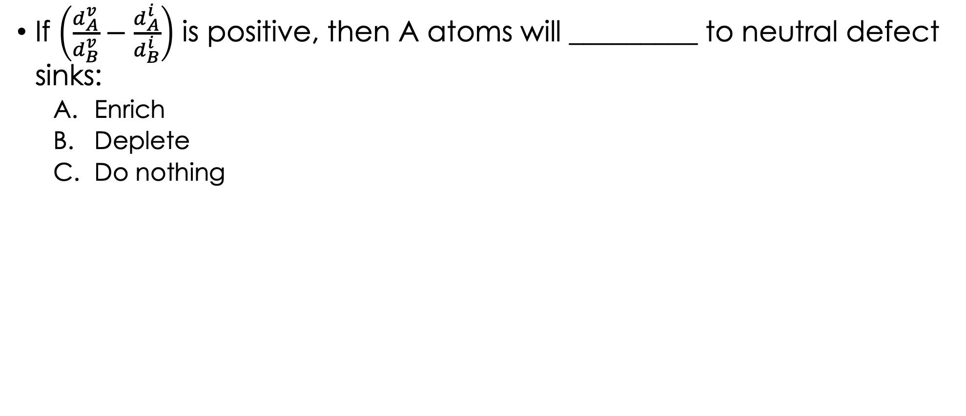
Radiation Induced Segregation
If $\left(\frac{d_{A}^{v}}{d_{B}^{v}}−\frac{d_{A}^{i}}{d_{B}^{i}}\right)$ is positive, then A atoms will _________ to neutral defect sinks:
Enrich
Deplete
Do nothing

Slide 9
Radiation Induced Segregation
Decreasing the dose rate will __________ the peak temperature for RIS:
Increase
Decrease

Slide 10
Radiation Induced Segregation
Your colleague proposes to introduce a third element in small quantities to a binary alloy that would change the vacancy migration energy of one of the primary alloying elements to reduce RIS. Is this a possible mechanism to reduce RIS?
Yes
No
Depends

Slide 11
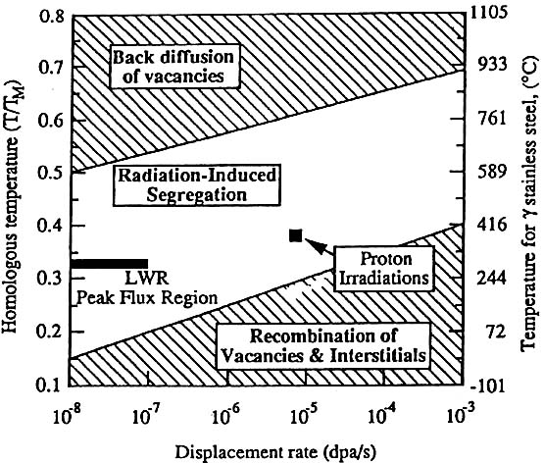
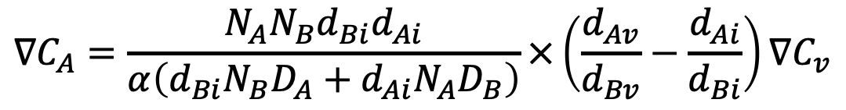
Radiation Induced Segregation
$$∇C_{A}=\frac{N_{A}N_{B}d_{Bi}d_{Ai}}{α\left(d_{Bi}N_{B}D_{A}+d_{Ai}N_{A}D_{B}\right)}×\left(\frac{d_{Av}}{d_{Bv}}−\frac{d_{Ai}}{d_{Bi}}\right)∇C_{v}$$

Slide 12
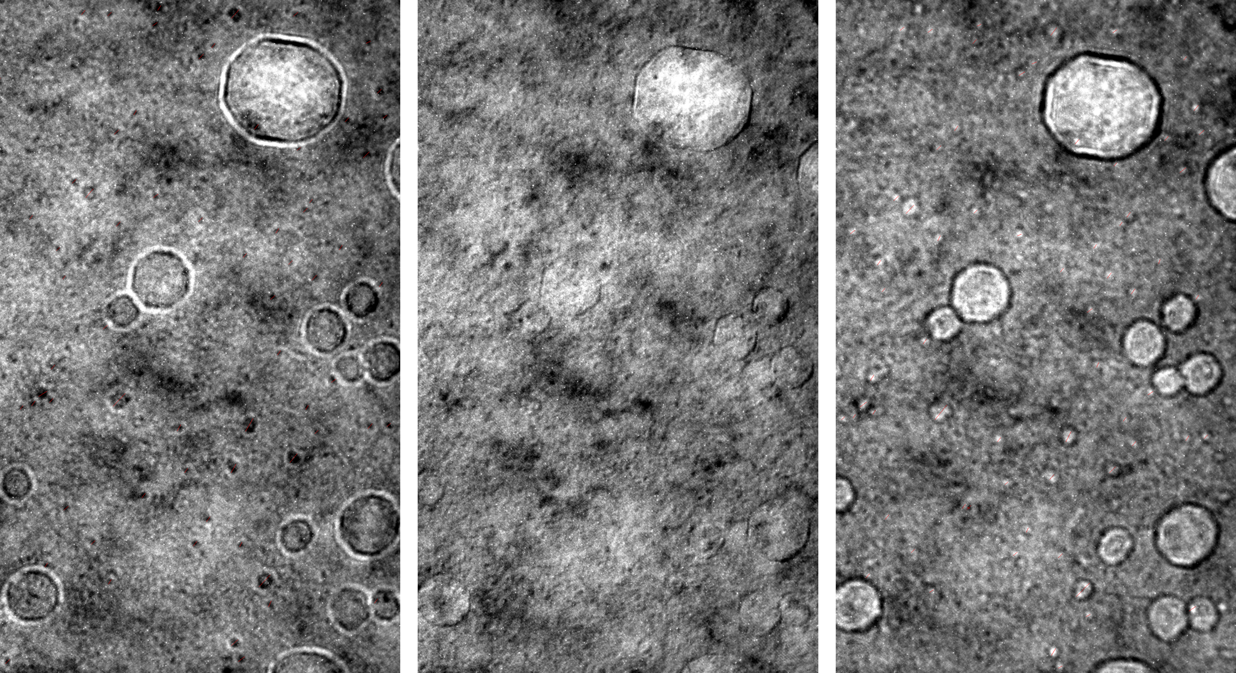
Characterization of Radiation Effects
The following set of images are produced using what type of characterization technique?
TEM
SEM
XRD
APT

Slide 13
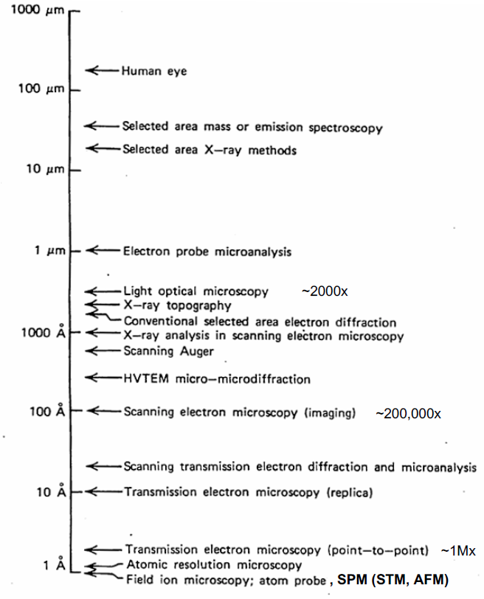
Characterization of Radiation Effects
Questions are almost always:
What does it look like?
What is it made out of?
XPS
XRD
SIMS
AFM
TEM
SEM
RBS
NRA
APT
EDS
EELS
Many more!

Slide 14
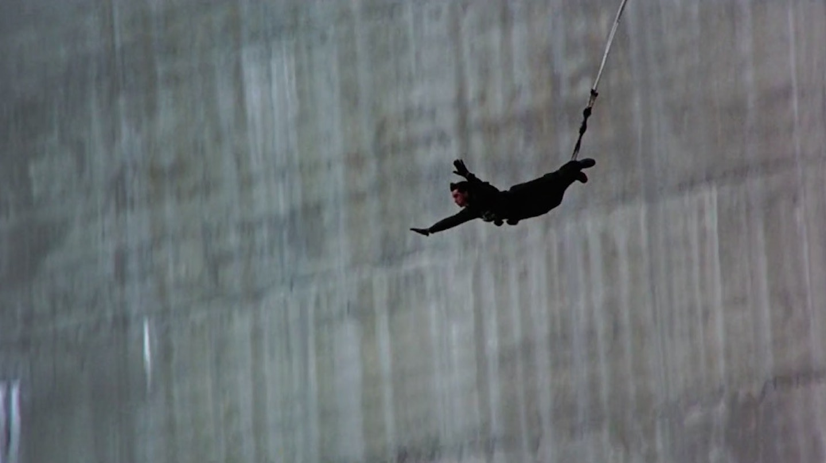
The 1995 Bond classic “Goldeneye” featured an opening scene where James Bond bungee jumping from a dam in Soviet Russia. At the time, the stunt held the world record for the tallest/longest jump. What was the total distance traveled?

Slide 15
Dislocation loops
Dislocation loops can grow by either absorption or emission of point defects under irradiation
True
False

Slide 16
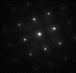
Formation Energies
In the micrograph for dislocation loops, the loops with “shadow” contrast are:
Faulted loops
Unfaulted lops

Slide 17
Formation Energies
When the stacking fault energy is high, faulted dislocation loops are:
Less stable
More stable

Slide 18
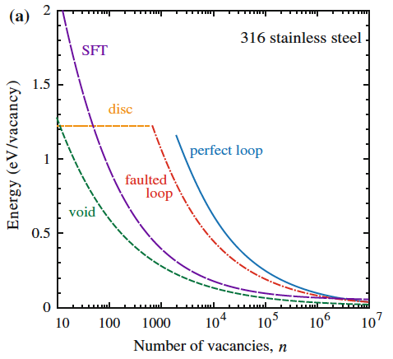
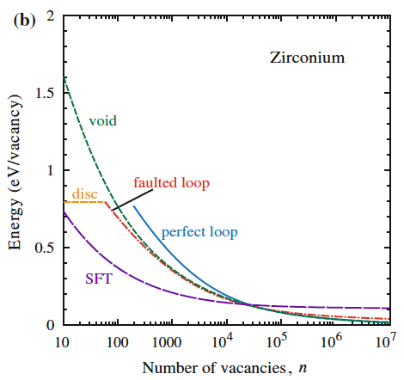
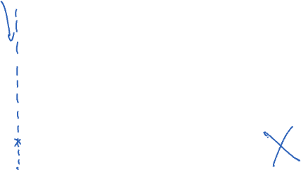
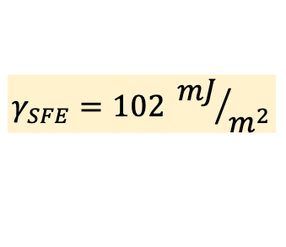
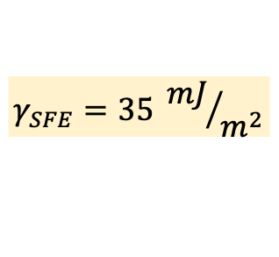
Visualizing the energetics
$$γ_{SFE}=35 {mJ}/{m^{2}}$$
$$γ_{SFE}=102 {mJ}/{m^{2}}$$

Slide 19
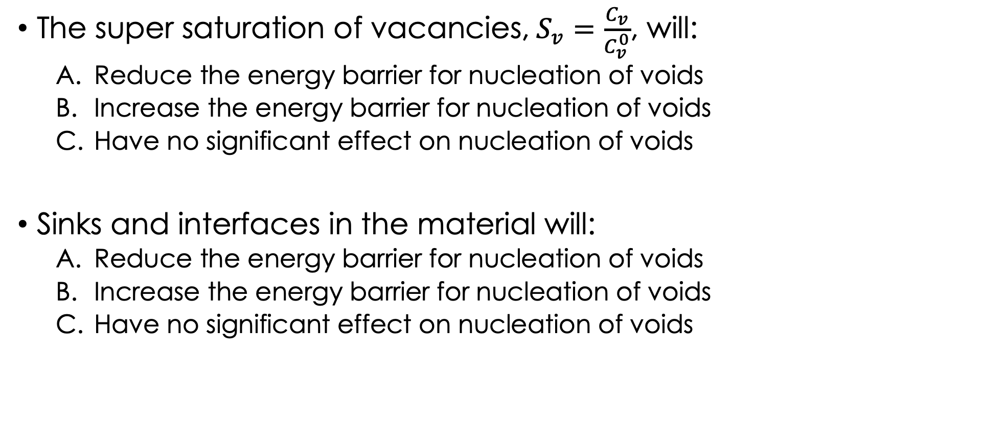
Void nucleation
The super saturation of vacancies,$S_{v}=\frac{C_{v}}{C_{v}^{0}}$, will:
Reduce the energy barrier for nucleation of voids
Increase the energy barrier for nucleation of voids
Have no significant effect on nucleation of voids
Sinks and interfaces in the material will:
Reduce the energy barrier for nucleation of voids
Increase the energy barrier for nucleation of voids
Have no significant effect on nucleation of voids

Slide 20
Design for Radiation Resistance III: High Sink Strength

Slide 21
Design for Radiation Resistance III: High Sink Strength
L.K. Mansur & E.H. Lee, J. Nucl. Mater. 179-181(1991) 105

Slide 22
Swelling
The bell shaped curve for swelling based on temperature is due to:
Recombination dominating at low temperatures, and thermal emission dominating at high temperatures
Recombination dominating at high temperatures, and thermal emission dominating at low temperatures

Slide 23
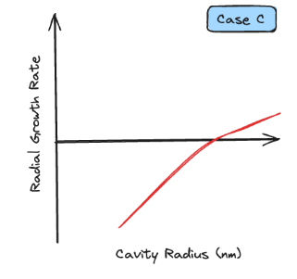
Void growth
The following radial growth rate curve for a cavity is representative of?
A void (no gas)
A high gas content bubble
A low gas content bubble

Slide 24
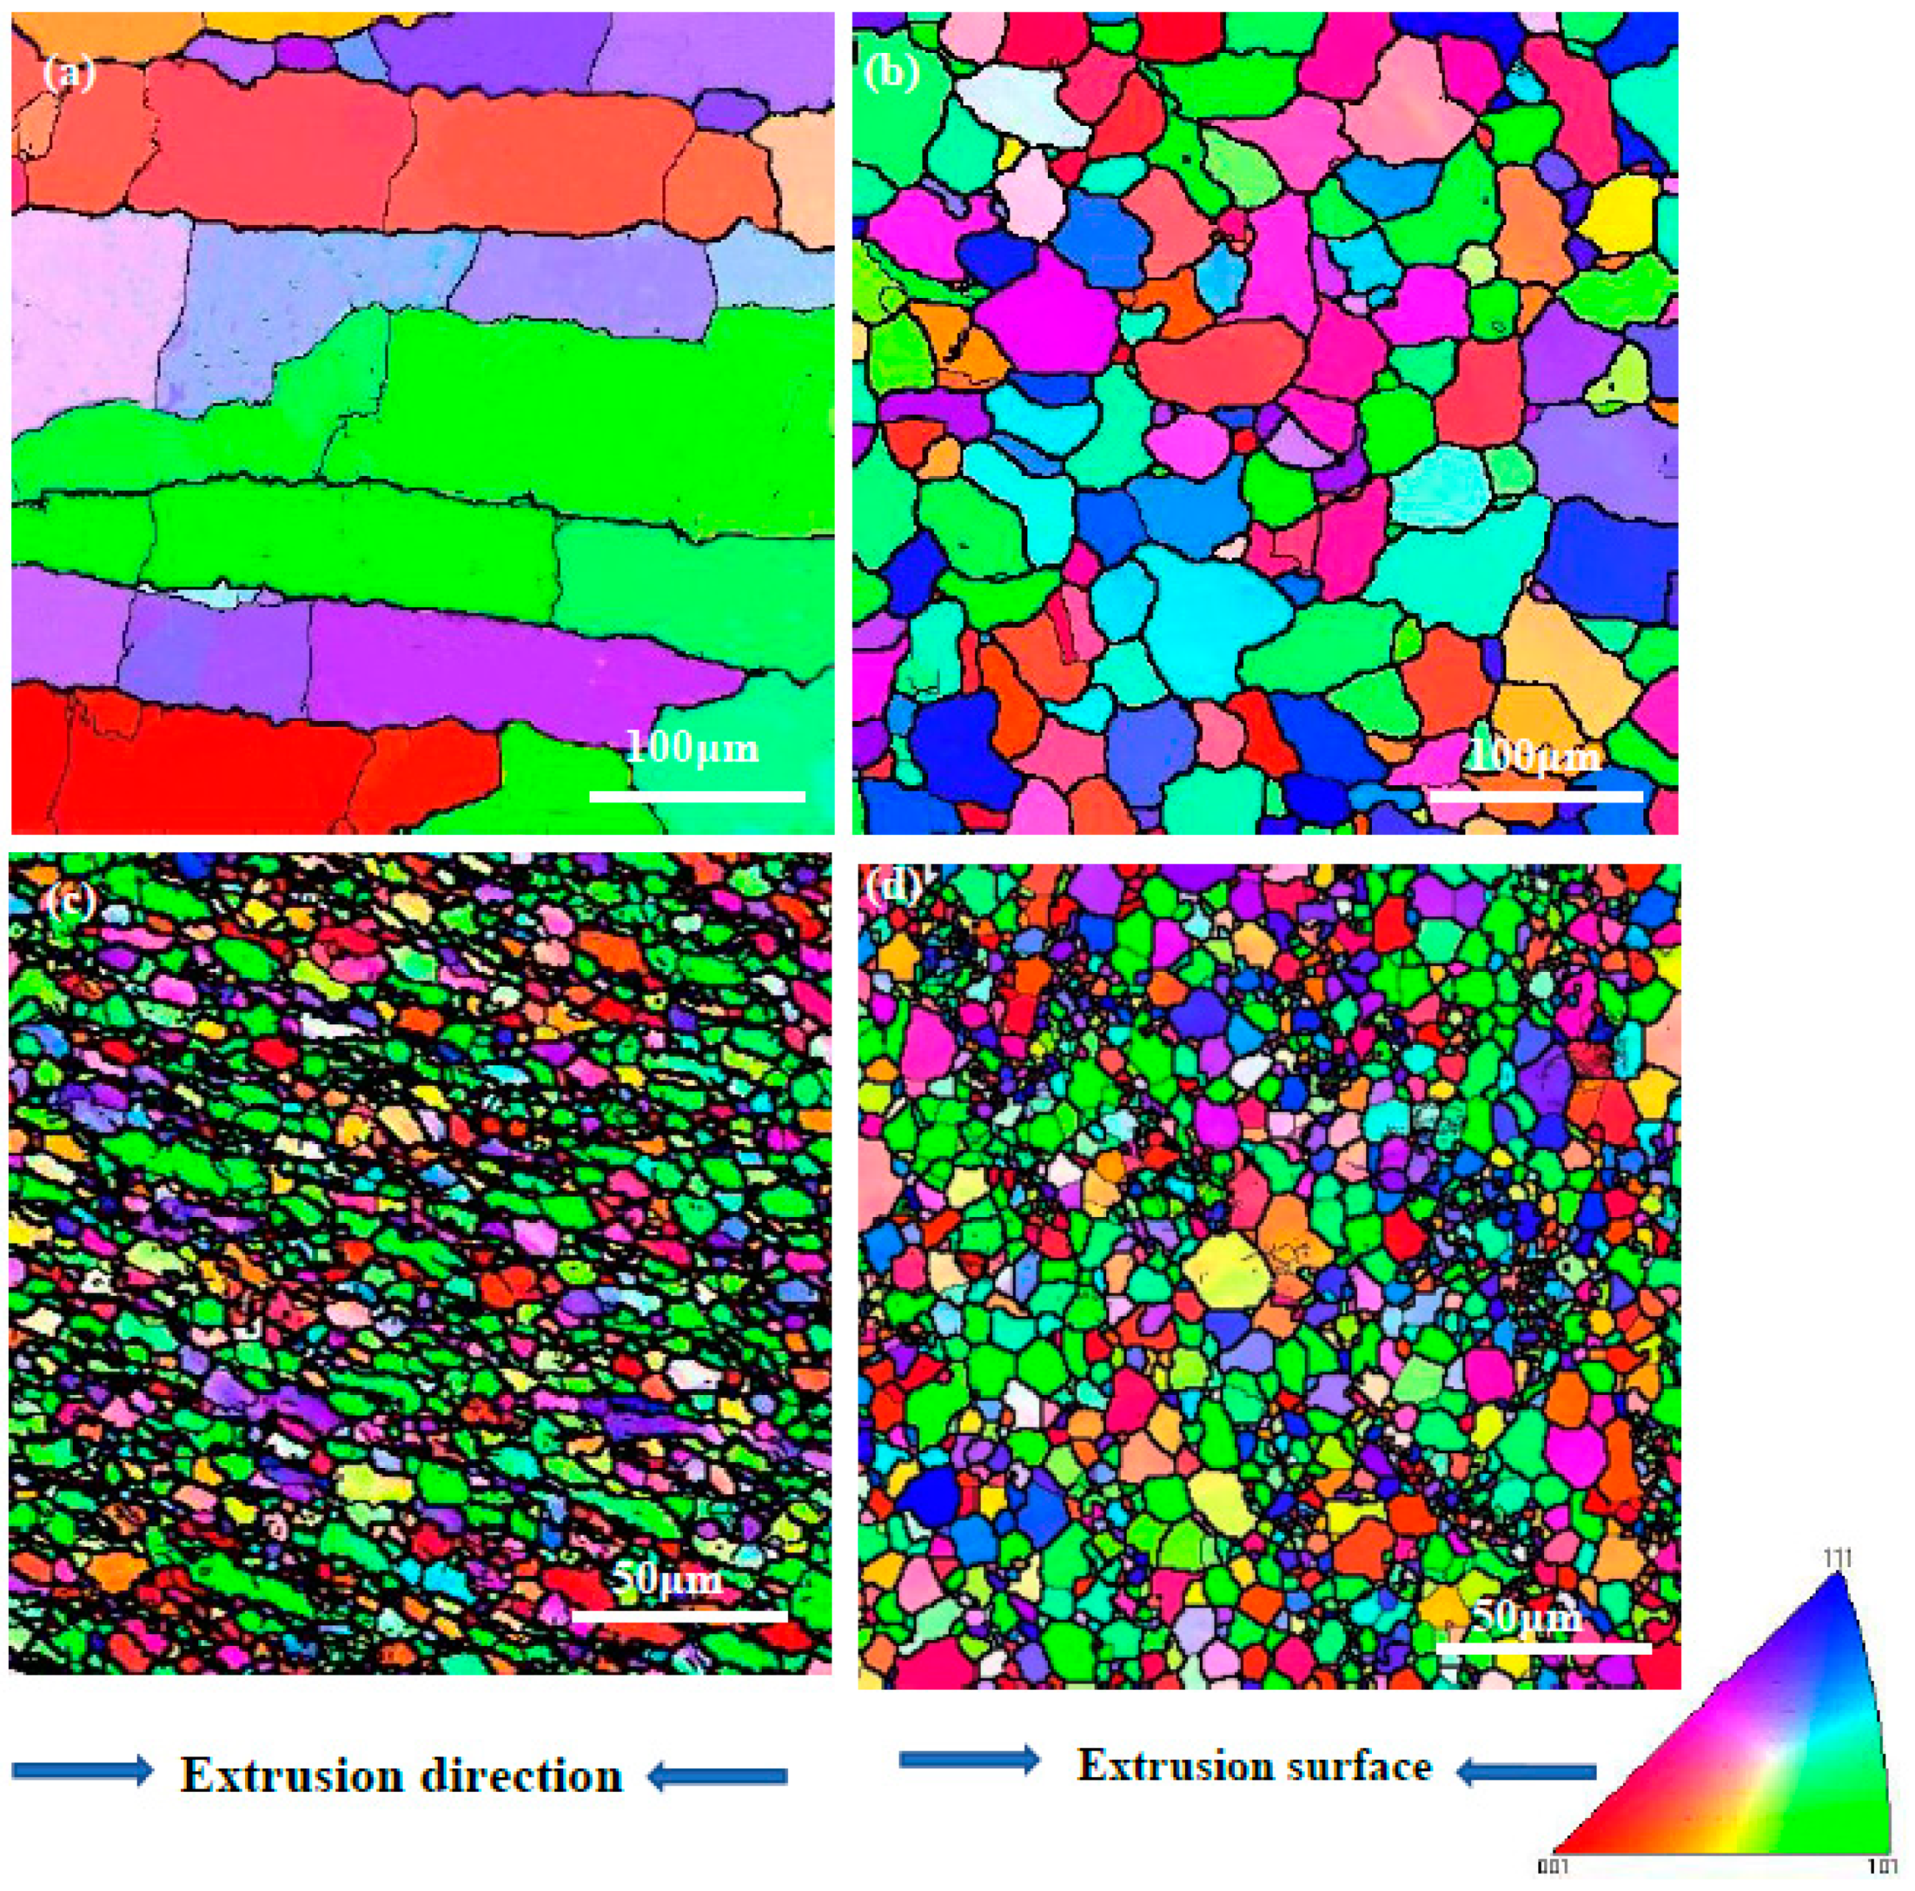
Swelling
What material would be more resistant to swelling?
A
B

Slide 25
Design for Radiation Resistance III: High Sink Strength
Early research also investigated fine grained architectures for radiation resistance, but sufficiently stable nanoscale grain boundaries were not discovered
Fine-grained materials are susceptible to radiation-enhanced grain growth
S.J. Zinkle, Nucl. Instr. Meth. B 91(1994)234
R. Yamada, S.J. Zinkle and G.P. Pells, J. Nucl. Mater. 209(1994) 191
L.K. Mansur & E.H. Lee, J. Nucl. Mater. 179-181(1991) 105

Slide 26
Bubbles
Gas atoms act to stabilize cavities and reduce the critical size to convert from a bubble embryo to a growing cavity.
True
False

Slide 27
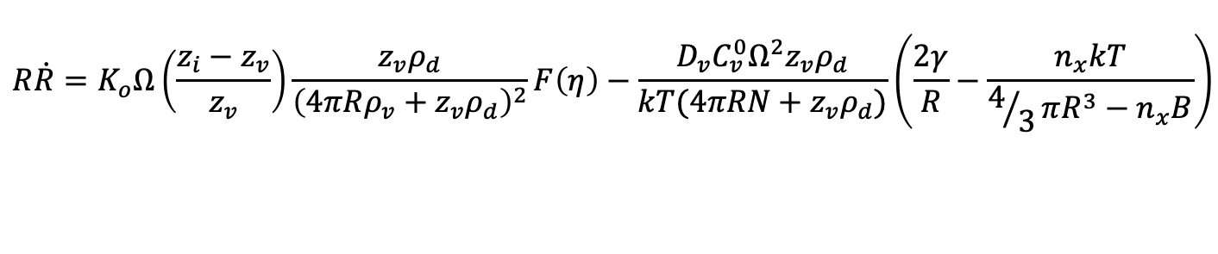
Bubbles
The full growth rate term can be analytically described as:
The different terms in order are:
Dose rate response, bias response, sink balance (Q), recombination response, thermal emission, gas response
Bias response, dose rate response, gas response, sink balance (Q), recombination response, thermal emission,
Bias response, gas response, sink balance (Q), recombination response, thermal emission, dose rate response,
Recombination response, bias response, sink balance (Q), dose rate response, thermal emission, gas response
$$R\dot{R}=K_{o}Ω\left(\frac{z_{i}−z_{v}}{z_{v}}\right)\frac{z_{v}ρ_{d}}{{\left(4πRρ_{v}+z_{v}ρ_{d}\right)}^{2}}F\left(η\right)−\frac{D_{v}C_{v}^{0}Ω^{2}z_{v}ρ_{d}}{kT(4πRN+z_{v}ρ_{d})}\left(\frac{2γ}{R}−\frac{n_{x}kT}{4/3πR^{3}−n_{x}B}\right)$$

Slide 28
Effect of gas atoms on bubble nucleation + growth

Slide 29
Quick review of void/bubble growth:
% Swelling
% Swelling
% Swelling
T_{irr}
Dose (dpa)
He/dpa

Slide 30
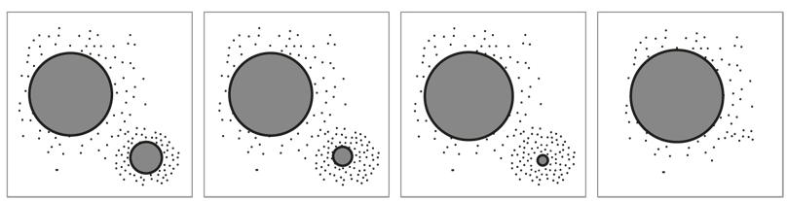
Phase stability
Ostwald AND Inverse Ostwald ripening can be accelerated due radiation:
True
False

Slide 31
Phase Transformations
The two primary mechanisms for precipitate stability under irradiation are:
Supersaturation and dislocation density
Recombination and diffusion
Diffusion and ballistic effects
Migration and formation energies

Slide 32
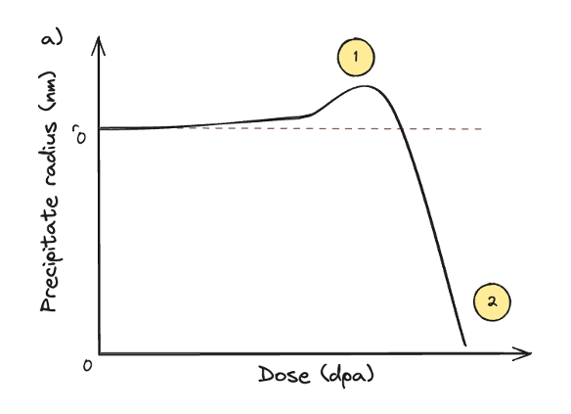

Slide 33
Take home message
Material Parameters
Irradiation Parameters
https://www.youtube.com/watch?v=F7IZZXQ89Oc

Slide 34

Take home message
Material Parameters
Irradiation Parameters
https://www.youtube.com/watch?v=F7IZZXQ89Oc

Slide 35
Thank you!

Slide 36
Questions?

